Slide 1
A Survey of South American Lizards Biodiversity and Ecological

Slide 2
Abstract
South America boasts a diverse range of lizard species, contributing significantly to the continent's biodiversity. This research paper aims to provide an overview of various South American lizard species, their unique characteristics, habitats, and ecological importance.

Slide 3
Biodiversity and Distribution of South American Lizards
South America is home to a diverse range of lizard families. Each family has its unique characteristics and adaptations to various habitats.

Slide 4
Iguanidae
Iguanidae is a family of lizards that includes the Green Iguana. Iguanidae members are arboreal and have long tails, strong limbs, and a herbivorous diet.

Slide 5
Teiidae
Teiidae are lizards known as whiptails or racerunners. They are known for their slender bodies and long tails.

Slide 6
Gymnophthalmidae
3 Gymnophthalmidae This family is composed of small, slender lizards often found in forested regions. They are characterized by their reduced limbs and elongated bodies, and they play essential roles in insect control within their ecosystems.

Slide 7
Gekkonidae
Geckos are nocturnal lizards with adhesive toe pads. The Gold Dust Day Gecko is an example of a gecko species found in South America.

Slide 8
Sphaerodactylidae
5. Sphaerodactylidae The Sphaerodactylidae family consists of small geckos known as \"dwarf geckos.\" These miniature lizards are often found in leaf litter and rocky areas, displaying a remarkable range of coloration and patterns.

Slide 9
Dactyloidae
The Anoles are members of the Dactyloidae family. Several species inhabit South America.

Slide 10
Leiosauridae
7. Leiosauridae This family comprises various \"perching lizards\" found across South America. They are typically diurnal and often seen basking in the sun on rocks and branches.

Slide 11
Polychrotidae
South America is home to a wide variety of lizard families. Polychrotidae, for example, contains the anole lizards. The continent's rich biodiversity is due in part to the ecological roles these lizards play in their respective habitats.

Slide 12
Representative Species
Representative Species Describe notable lizard species from different families found in South America, including but not limited to the following examples:

Slide 13
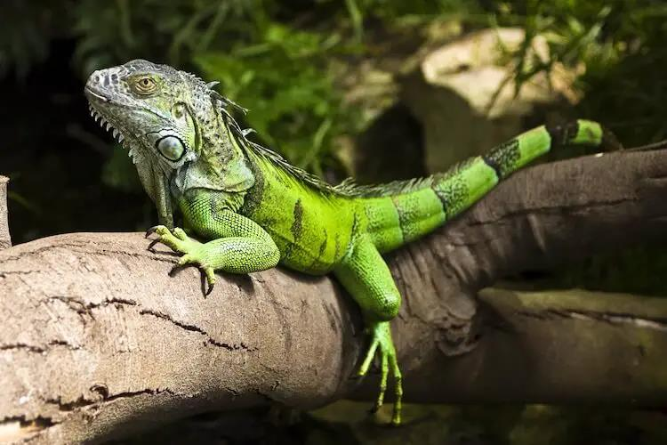

Slide 14
Green Iguana (Iguana iguana)
The Green Iguana is a large lizard species found in Central and South America. It is known for its vibrant green coloration and spends much of its time in the treetops.

Slide 15
Caiman Lizard (Dracaena guianensis)
The Caiman Lizard (Dracaena guianensis) is a captivating reptile native to South America. It is semiaquatic and possesses a unique set of features, including a serrated tail. It plays a vital role in controlling aquatic vegetation and maintaining ecological balance. However, it faces threats such as habitat destruction and illegal trade, requiring conservation efforts.

Slide 16
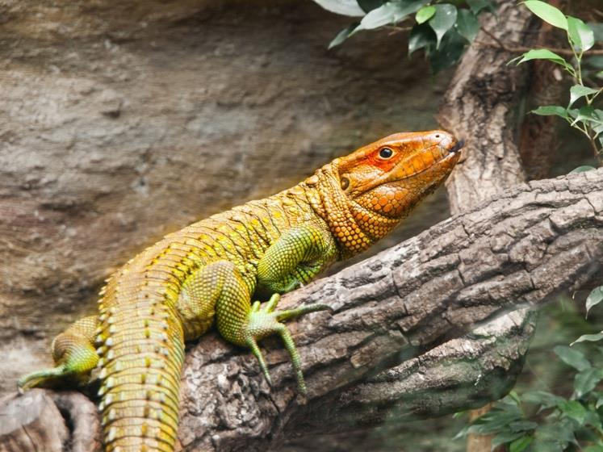

Slide 17
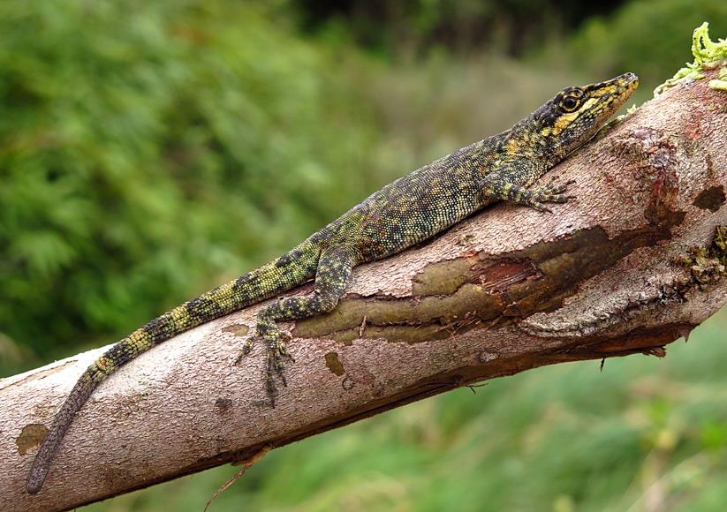

Slide 18
Tepui Lizard (Pristidactylus urichi)
The Tepui Lizard (Pristidactylus urichi) is a captivating reptile inhabiting the isolated Tepui plateaus of South America. Its remarkable adaptations to its specific surroundings make it ecologically significant as an indicator of the overall health and stability of these isolated ecosystems.

Slide 19
Threats and Conservation
The Green Iguana, Caiman Lizard, and Tepui Lizard are all threatened by habitat loss and other human activities. To conserve these species, efforts should focus on establishing protected areas and reserves, combating illegal pet trade, and minimizing pollution and climate change impacts.

Slide 20
Ecological Roles
South American lizards play crucial ecological roles within their respective habitats, contributing significantly to the overall balance and health of their ecosystems.

Slide 21
Conclusion
South American lizards are a diverse group of reptiles that play important roles in their respective ecosystems. They face numerous threats, such as habitat loss, climate change, and illegal trade, which necessitate urgent conservation efforts.

